Slide 1
Subprograms
BBM 301 – Programming Languages

Slide 2
Fundamentals of Subprograms
Each subprogram has a single entry point
The calling program is suspended during execution of the called subprogram
  Therefore, only one subprogram is in execution at a given time
Control always returns to the caller when the called subprogram’s execution terminates
Copyright © 2009 Addison-Wesley. All rights reserved.
1-<number>

Slide 3
Basic Definitions
A subprogram definition describes the interface to and the actions of the subprogram abstraction
  In Python, function definitions are executable; in all other languages, they are non-executable
  if ….
  def fun1(…);
  else
  def fun2(…);
…
Copyright © 2009 Addison-Wesley. All rights reserved.
1-<number>

Slide 4
Basic Definitions
A subprogram header is the first part of the definition, including the name, the kind of subprogram, and the formal parameters
    FORTRAN example:
    SUBROUTINE name (parameters)
    C example:
    void adder(parameters)
A subprogram call is an explicit request that the subprogram be executed
Copyright © 2009 Addison-Wesley. All rights reserved.
1-<number>

Slide 5
Basic Definitions (cont’d.)
The parameter profile (aka signature) of a subprogram is the number, order, and types of its parameters
The protocol is a subprogram’s parameter profile and, if it is a function, its return type
Copyright © 2009 Addison-Wesley. All rights reserved.
1-<number>

Slide 6
Basic Definitions (cont’d.)
Function declarations in C and C++ are often called prototypes
A subprogram declaration provides the protocol, but not the body, of the subprogram
A formal parameter is a dummy variable listed in the subprogram header and used in the subprogram
An actual parameter represents a value or address used in the subprogram call statement
Copyright © 2009 Addison-Wesley. All rights reserved.
1-<number>

Slide 7
Actual/Formal Parameter Correspondence
Positional
  The binding of actual parameters to formal parameters is by position: the first actual parameter is bound to the first formal parameter and so forth
  Safe and effective
Keyword
  The name of the formal parameter to which an actual parameter is to be bound is specified with the actual parameter
  Advantage: Parameters can appear in any order, thereby avoiding parameter correspondence errors
  Disadvantage: User must know the formal parameter’s names
Copyright © 2009 Addison-Wesley. All rights reserved.
1-<number>

Slide 8
Parameters
Example in Ada,
SUMER (LENGTH => 10,
LIST => ARR,
SUM => ARR_SUM);
Formal parameters: LENGTH, LIST, SUM.
Actual parameters: 10, ARR, ARR_SUM.
The programmer doesn’t have to know the order of the formal parameters.
But, must know the names of the formal parameters.
1-<number>

Slide 9
Parameters
Ada, and FORTRAN 90 allow positional parameters and keyword parameters to be used together.
SUMER (10, SUM => ARR_SUM, LIST => ARR);
Once a keyword appears in the call, all remaining parameters must be keyword parameters.
1-<number>

Slide 10
Formal Parameter Default Values
In certain languages (e.g., C++, Python, Ruby, Ada, PHP), formal parameters can have default values (if no actual parameter is passed)
  In C++, default parameters must appear last because parameters are positionally associated
Ada example:
function Comp_Pay (Income: Float;
Examptions: Integer := 1;
Tax_Rate: Float) return Float;
Therefore, the call doesn’t have to provide values for all parameters.
A sample call may be
Pay := Comp_Pay (2000.0, Tax_Rate => 0.23);
Copyright © 2009 Addison-Wesley. All rights reserved.
1-<number>

Slide 11
Procedures and Functions
There are two categories of subprograms
  Procedures are collection of statements that define parameterized computations
  Functions structurally resemble procedures but are semantically modeled on mathematical functions
    They are expected to produce no side effects
    In practice, program functions have side effects
Copyright © 2009 Addison-Wesley. All rights reserved.
1-<number>

Slide 12
Design Issues for Subprograms
Are local variables static or dynamic?
Can subprogram definitions appear in other subprogram definitions?
What parameter passing methods are provided?
Are parameter types checked?
If subprograms can be passed as parameters and subprograms can be nested, what is the referencing environment of a passed subprogram?
Can subprograms be overloaded?
Can subprogram be generic?
Copyright © 2009 Addison-Wesley. All rights reserved.
1-<number>

Slide 13
Semantic Models of Parameter Passing
In mode
Out mode
Inout mode
Copyright © 2009 Addison-Wesley. All rights reserved.
1-<number>

Slide 14
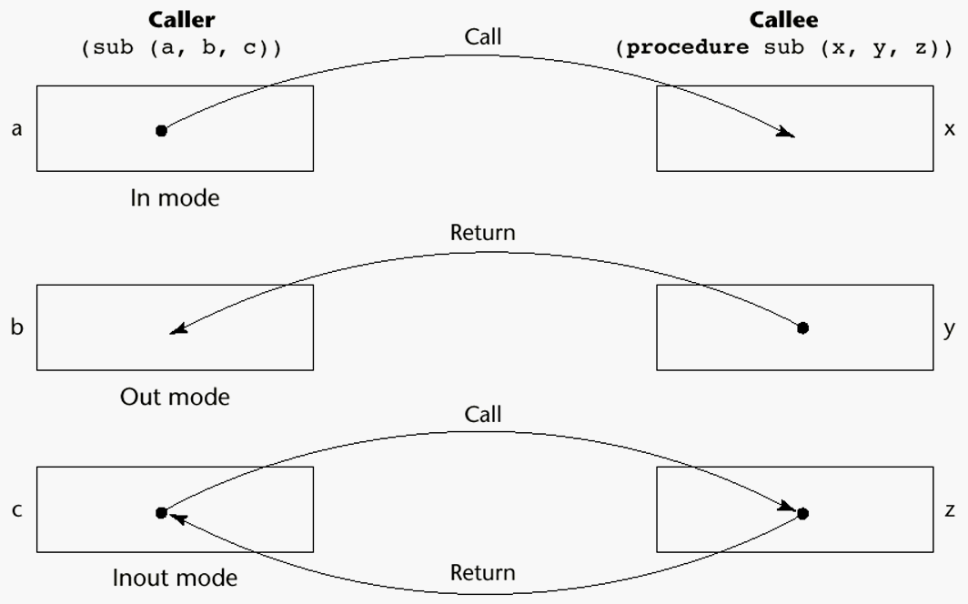
Models of Parameter Passing
Copyright © 2009 Addison-Wesley. All rights reserved.
1-<number>

Slide 15
Parameter Passing Methods
Ways in which parameters are transmitted to and/or from called subprograms
  Pass-by-value
  Pass-by-result
  Pass-by-value-result
  Pass-by-reference
  Pass-by-name
1-<number>

Slide 16
Pass-by-Value (In Mode)
The value of the actual parameter is used to initialize the corresponding formal parameter
  Normally implemented by copying
  Can be implemented by transmitting an access path but not recommended (enforcing write protection is not easy)
  Advantages: Actual variable is protected.
  Disadvantages: additional storage is required (stored twice) and the actual move can be costly (for large parameters)
Copyright © 2009 Addison-Wesley. All rights reserved.
1-<number>

Slide 17
Pass-by-Result (Out Mode)
No value is transmitted to the subprogram
The corresponding formal parameter acts as a local variable
its value is transmitted to caller’s actual parameter when control is returned to the caller
  Require extra storage location and copy operation
Potential problems:
  sub(p1, p1); whichever formal parameter is copied back will represent the current value of p1
  sub(list[sub], sub); Compute address of list[sub] at the beginning of the subprogram or end?
Copyright © 2009 Addison-Wesley. All rights reserved.
1-<number>

Slide 18
Pass-by-Result (Out Mode)
Problem: Actual parameter collision definition:
subprogram sub(x, y) { x <- 3 ; y <-5;}
call:
sub(p, p)
what is the value of p here ? (3 or 5?)
• The values of x and y will be copied back to p. Which ever is assigned last will determine the value of p.
• The order is important
• The order is implementation dependent ⇒ Portability problems.

Slide 19
Pass-by-Result (Out Mode)
Problem: Time to evaluate the address of the actual parameter
– at the time of the call
– at the time of the return
• The decision is up to the implemention.
Definition:
subprogram sub(x)
i <-5 is changed as a global variable here
x <- ..
call:
i <- 3
sub(A[i])
Is A[3] or A[5] is changed?
The decision is up to the implemention.

Slide 20
Pass-by-Value-Result (inout Mode)
A combination of pass-by-value and pass-by-result
Sometimes called pass-by-copy
Formal parameters have local storage
Disadvantages:
  Those of pass-by-result
  Those of pass-by-value
The value of the actual parameter is used to initialize the corresponding formal parameter
  the formal parameter acts as a local parameter
  At termination, the value of the formal parameter is copied back.
Copyright © 2009 Addison-Wesley. All rights reserved.
1-<number>

Slide 21
Pass-by-Reference (Inout Mode)
Pass an access path
Also called pass-by-sharing
Advantage:
  Passing process is efficient
  no copying
  no duplicated storage
Disadvantages
  Slower accesses (compared to pass-by-value) to formal parameters
  Potentials for unwanted side effects (collisions)
  Unwanted aliases (access broadened)
  fun(total, total); fun(list[i], list[j]; fun(list[i], i);
Copyright © 2009 Addison-Wesley. All rights reserved.
1-<number>

Slide 22
Pass-by-Reference
Dangerous: Actual parameter may be modified unintentionally.
Aliasing:
definition:
subprogram sub(x, y)
call:
sub(p, p)
Here, x and y in the subprogram are aliases.
• Another way of aliasing:
definition:
var x global variable
subprogram sub(y)
call:
sub(x)
Here, x and y in the subprogram are aliases.
1-<number>

Slide 23
Pass by : Example
1-<number>

Slide 24
Pass-by-Name (Inout Mode)
By textual substitution: Actual parameter is textually substituted for the corresponding formal parameter in all occurrences in the subprogram.
Late binding: actual binding to a value or an address is delayed until the formal parameter is assigned or referenced.
Allows flexibility in late binding
Copyright © 2009 Addison-Wesley. All rights reserved.
1-<number>

Slide 25
Pass-by-name
If the actual parameter is a scalar variable, then it is equivalent to pass-by-reference.
If the actual parameter is a constant expression, then it is equivalent to pass-by-value.
Advantage: flexibility
Disadvantage: slow execution, difficult to implement, confusing.
1-<number>

Slide 26
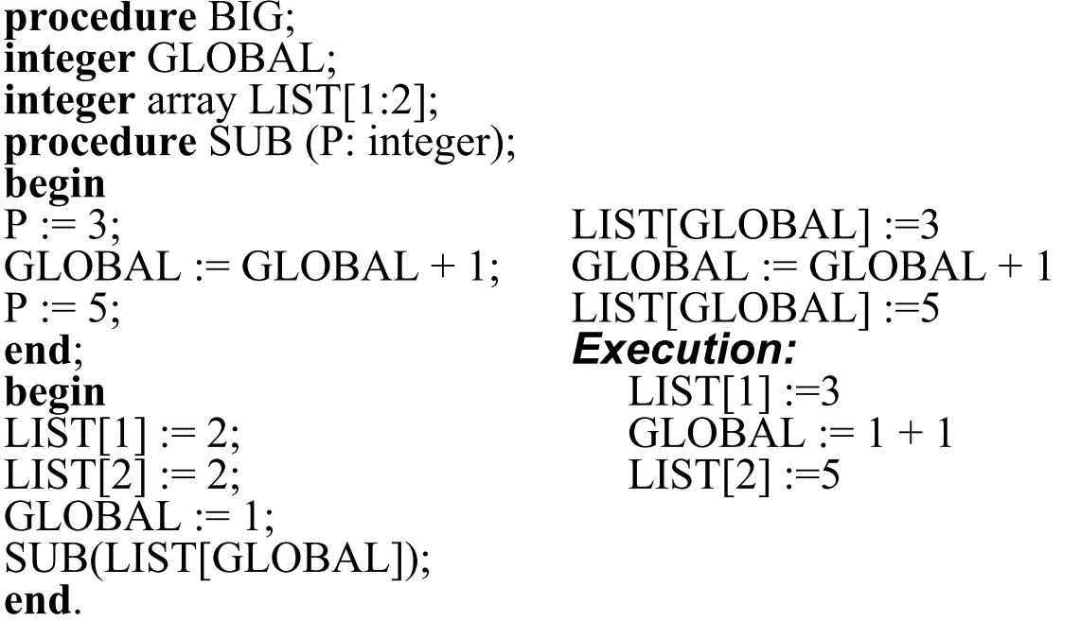
Pass-by-name
1-<number>

Slide 27
Pass-by-Name Elegance:
Jensen's Device
Passing expressions into a routine so they can be repeatedly evaluated has some valuable applications.
Consider calculations of the form: "sum xi × i for all i from 1 to n." How could a routine Sum be written so that we could express this as
sum(i, 1, n, x[i]*i) ?
Using pass-by-reference or pass-by-value, we cannot do this because we would be passing in only a single value of x[i]*i, not an expression which can be repeatedly evaluated as "i" changes.
Using pass-by-name, the expression x[i]*i is passed in without evaluation.
1-<number>

Slide 28
Pass-by-Name Elegance:
Jensen's Device
real procedure Sum(j, lo, hi, Ej);
value lo, hi;
integer j, lo, hi;
real Ej;
begin
real S; S := 0;
for j := lo step 1 until hi do
S := S + Ej;
Sum := S
end;
Each time through the loop, evaluation of Ej is actually the evaluation of the expression x[i]*i = x[j]*j.
1-<number>

Slide 29

Pass-By-Name Security Problem (Severe)
A sample program:
  procedure swap (a, b);
  integer a, b, temp;
  begin temp := a; a := b; b:= temp end;
Effect of the call swap(x, y):
  temp := x; x := y; y := temp
Effect of the call swap(i, x[i]):
  temp := i; i := x[i]; x[i] := temp
  It doesn't work! For example:
It is very difficult to write a correct swap procedure in Algol.
1-<number>

Slide 30
Implementing Parameter-Passing Methods
In most language parameter communication takes place thru the run-time stack
Pass-by-reference is the simplest to implement; only an address is placed in the stack
A subtle but fatal error can occur with pass-by-reference and pass-by-value-result:
  A formal parameter corresponding to a constant can mistakenly be changed
Copyright © 2009 Addison-Wesley. All rights reserved.
1-<number>

Slide 31
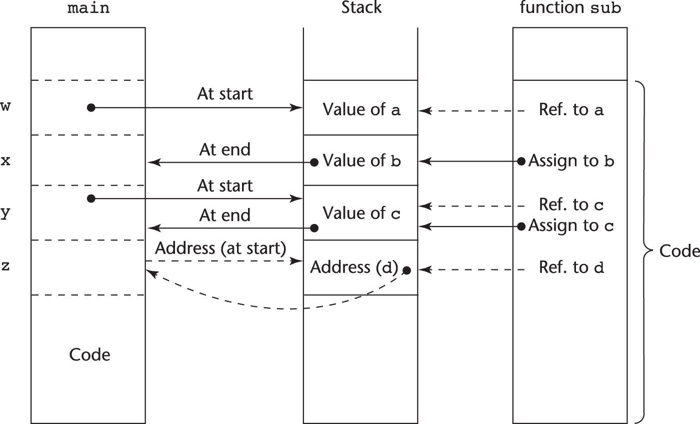
Implementing Parameter-Passing Methods
Function header: void sub(int a, int b, int c, int d)
Function call in main: sub(w, x, y, z)
(pass w by value, x by result, y by value-result, z by reference)
Copyright © 2012 Addison-Wesley. All rights reserved.
1-<number>

Slide 32

Parameter Passing Methods of Major Languages
C
  Pass-by-value
  Pass-by-reference is achieved by using pointers as parameters
C++
  A special pointer type called reference type for pass-by-reference
Java
  All parameters are passed are passed by value
  Object parameters are passed by reference
Ada
  Three semantics modes of parameter transmission: in, out, in out; in is the default mode
  Formal parameters declared out can be assigned but not referenced; those declared in can be referenced but not assigned; in out parameters can be referenced and assigned
Copyright © 2009 Addison-Wesley. All rights reserved.
1-<number>

Slide 33
Design Considerations for Parameter Passing
Two important considerations
  Efficiency
  One-way or two-way data transfer
But the above considerations are in conflict
  Good programming suggest limited access to variables, which means one-way whenever possible
  But pass-by-reference is more efficient to pass structures of significant size
Copyright © 2009 Addison-Wesley. All rights reserved.
1-<number>

Slide 34
Parameters that are Subprogram Names
It is sometimes convenient to pass subprogram names as parameters
Issues:
  Are parameter types checked?
  What is the correct referencing environment for a subprogram that was sent as a parameter?
Copyright © 2009 Addison-Wesley. All rights reserved.
1-<number>

Slide 35
Parameters that are Subprogram Names: Referencing Environment
Q: What is the referencing environment for executing the passed subprogram? (For non local variables)
Shallow binding: The environment of the call statement that enacts the passed subprogram
- Most natural for dynamic-scoped languages
Deep binding: The environment of the definition of the passed subprogram
- Most natural for static-scoped languages
Ad hoc binding: The environment of the call statement that passed the subprogram
Copyright © 2009 Addison-Wesley. All rights reserved.
1-<number>

Slide 36
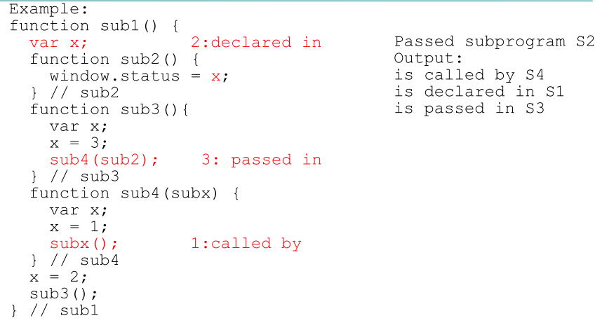
Parameters that are Subprograms
1- Shallow binding
2- Deep binding
3- Ad hoc binding
1-<number>

Slide 37
Overloaded Subprograms
An overloaded subprogram is one that has the same name as another subprogram in the same referencing environment
  Every version of an overloaded subprogram has a unique protocol (different number of arguments,etc)
  The correct meaning (the correct code) to be invoked is determined by the actual parameter list.
  In case of functions, the return type may be used to distinguish.
Ada, Java, C++, and C# allow users to write multiple versions of subprograms with the same name
Copyright © 2009 Addison-Wesley. All rights reserved.
1-<number>

Slide 38
Generic Subprograms
A generic or polymorphic subprogram takes parameters of different types on different activations
The same formal parameter can get values of different types.
Ada and C++ provide Generic (Polymorphic) Subprograms
Copyright © 2009 Addison-Wesley. All rights reserved.
1-<number>

Slide 39
Design Issues for Functions
Are side effects allowed?
  Parameters should always be in-mode to reduce side effect (like Ada)
What types of return values are allowed?
  Most imperative languages restrict the return types
  C allows any type except arrays and functions
  C++ is like C but also allows user-defined types
  Ada subprograms can return any type (but Ada subprograms are not types, so they cannot be returned)
  Java and C# methods can return any type (but because methods are not types, they cannot be returned)
  Python and Ruby treat methods as first-class objects, so they can be returned, as well as any other class
Copyright © 2009 Addison-Wesley. All rights reserved.
1-<number>

Slide 40
Coroutines
A coroutine is a special kind of a subprogram that has multiple entries and controls them itself
Also called symmetric control: caller and called coroutines are on a more equal basis
Coroutines call is a resume. The first resume of a coroutine is to its beginning, but subsequent calls enter at the point just after the last executed statement in the coroutine
Coroutines provide quasi-concurrent execution of program units (the coroutines); their execution is interleaved, but not overlapped
Coroutines are history sensitive, thus they have static variables.
Couroutines are created in an application by a special unit called master unit, which is not a coroutine.
A coroutine may have an initialization code that is executed only when it is created.
Only one coroutine executes at a given time.
1-<number>

Slide 41
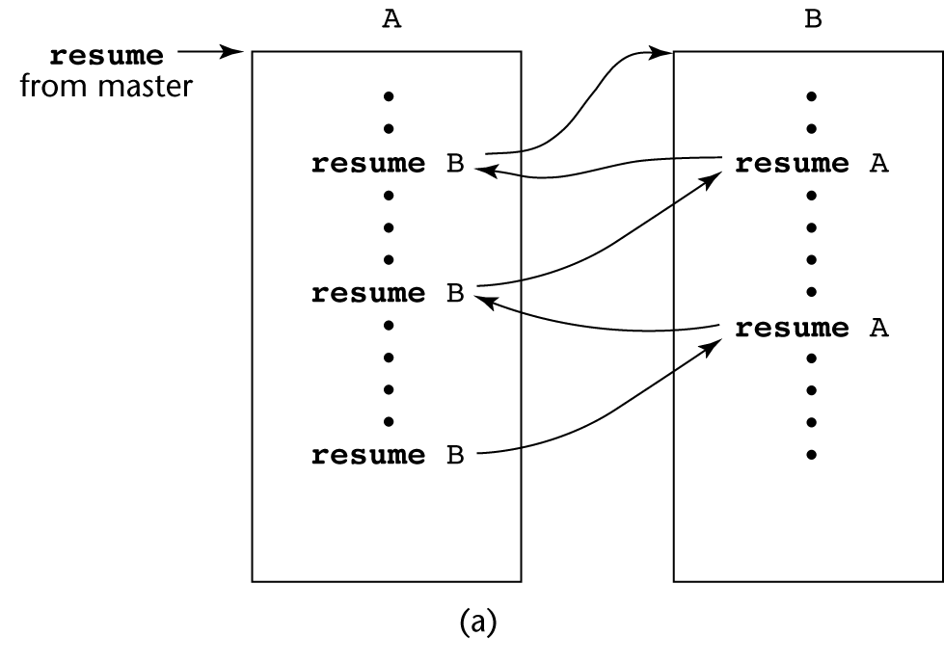
Coroutines Illustrated: Possible Execution Controls
Copyright © 2009 Addison-Wesley. All rights reserved.
1-<number>

Slide 42
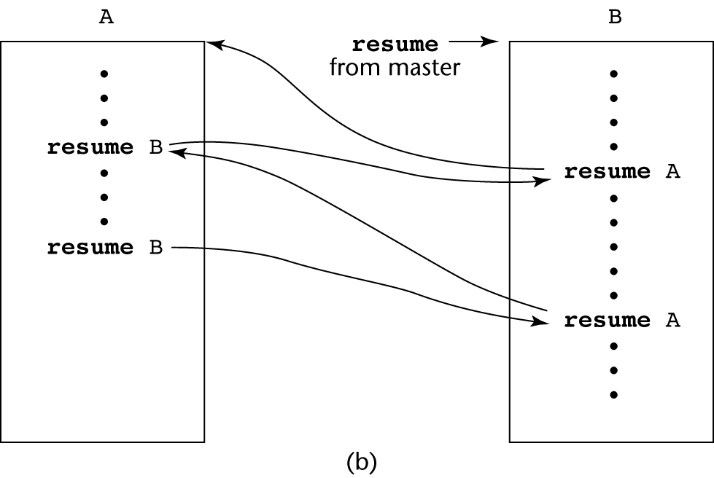
Coroutines Illustrated: Possible Execution Controls
Copyright © 2009 Addison-Wesley. All rights reserved.
1-<number>

Slide 43
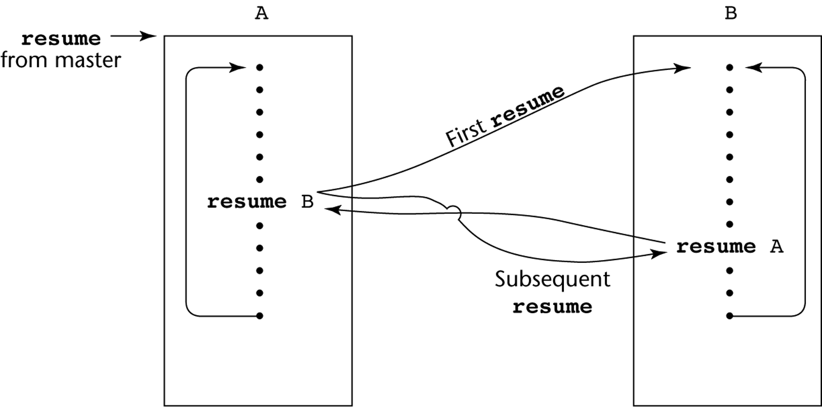
Coroutines Illustrated: Possible Execution Controls with Loops
Copyright © 2009 Addison-Wesley. All rights reserved.
1-<number>

Slide 44
Summary
A subprogram definition describes the actions represented by the subprogram
Subprograms can be either functions or procedures
Local variables in subprograms can be stack-dynamic or static
Three models of parameter passing: in mode, out mode, and inout mode
Some languages allow operator overloading
Subprograms can be generic
A coroutine is a special subprogram with multiple entries
Copyright © 2009 Addison-Wesley. All rights reserved.
1-<number>

